Slide 1
OPERATION 2ND HAND SMOKE

Slide 2
Event: 1230 – 1400
Flight:

Slide 3
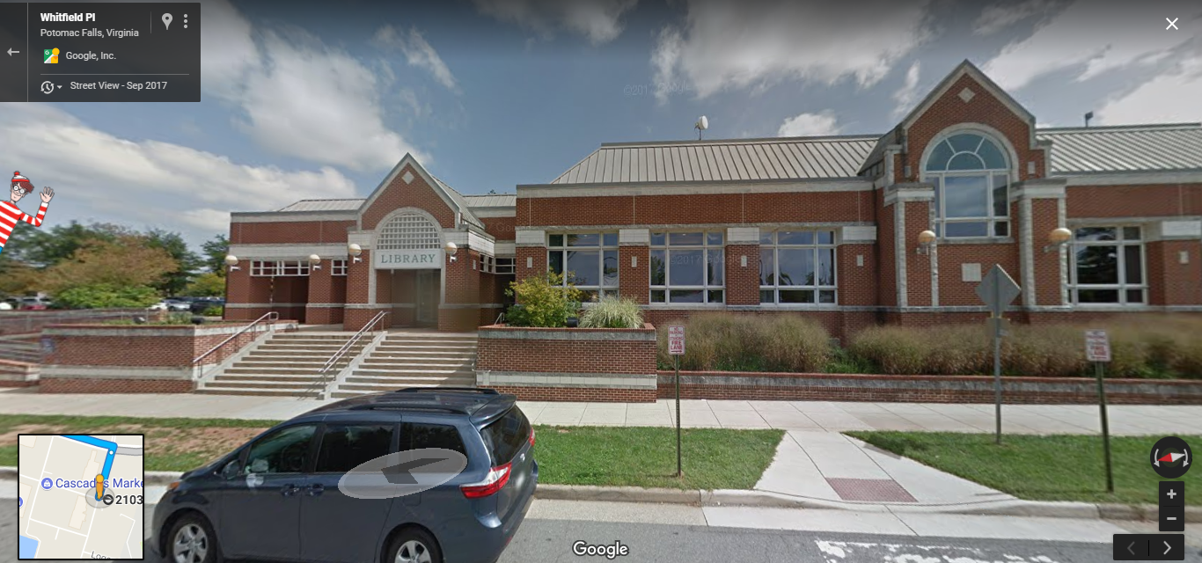

Slide 4
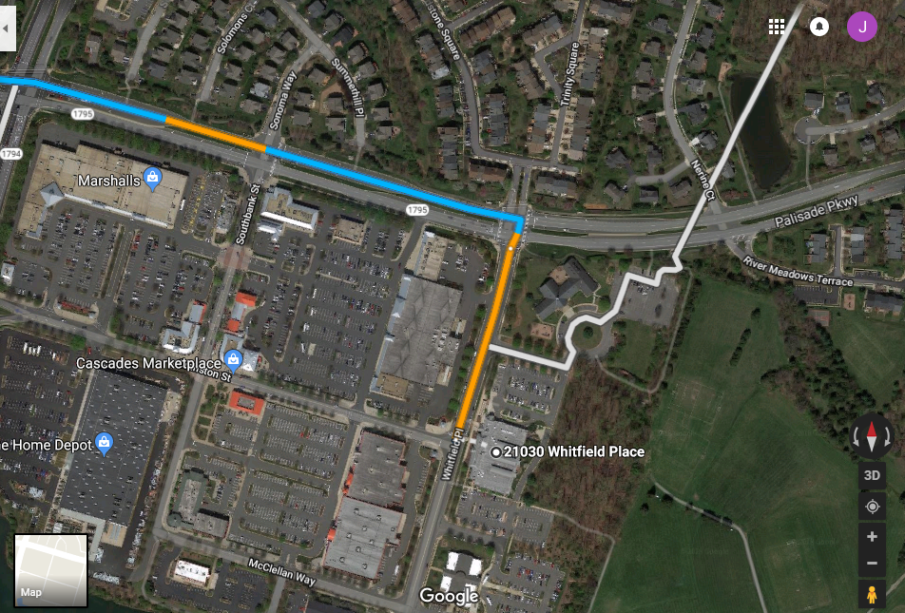
Park

Slide 5
